Slide 1
Foundation Safeguarding & Child Protection Training

Slide 2
Ground Rules
Child abuse can be a distressing and sensitive issue. Please ensure that you look after yourself and colleagues if you are affected by the training
Confidentiality
Respect each other’s views
Timekeeping
Please switch your phones to silent
Please ask questions – lots of questions

Slide 3
Aims & Objectives
Aim: Increase your overall understanding of safeguarding and child protection in relation to your setting.

Slide 4
Aims & Objectives
Objectives:
Identify the legislation and guidance for safeguarding children in your setting
Describe own role in keeping children safe in our setting
Demonstrate knowledge of the signs and symptoms of different types of child abuse
Demonstrate understanding of how and why we work with other agencies to safeguard children
Explain what to do if you have safeguarding concerns about a child or young person, concerns about a colleague, or about the safeguarding practices within an organisation.

Slide 5
From 7th September 2019 the Keeping Bristol Safe Partnership is constituted to deliver the following statutory duties as follows:
To safeguard and promote the welfare of children as required by The Children Act 2004 and supported by the statutory guidance, Working Together to Safeguard Children 2018
To help and protect adults with care and support needs at risk of abuse or neglect as defined by the Care Act 2014 and supporting statutory guidance
To reduce crime and disorder, substance misuse and re-offending as required by the Crime and Disorder Act 1998

Slide 6
To cooperate to improve the wellbeing of children and young people as defined in The Children Act 2004
The Local Arrangements 2019-20 sets out how the partnership will work together to respond to the changes as prescribed in Working Together 2018. They can be found here: https://bristolsafeguarding.org/media/42653/keeping-bristol-safe-parthership-local-arrangements-2019-20.pdf
The safeguarding partners in the city, along with local agencies and organisations are committed to the transformational journey to improve local safeguarding arrangements and outcomes for children, adults and communities.
The three statutory partners are:
Bristol City Council
Avon and Somerset Police
Bristol, North Somerset, South Gloucestershire CCG (BNSSG)

Slide 7
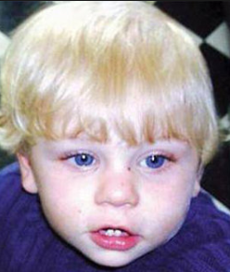
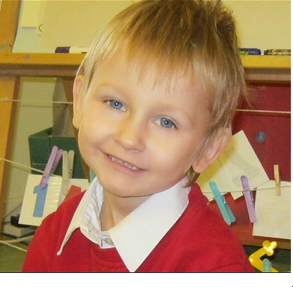
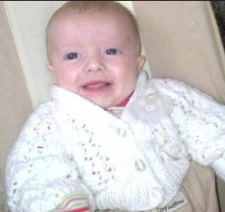
Why is this Important?
Who are these children?
What do they have in common?

Slide 8
Legislation and Guidance
We ALL have a duty to work with local authorities to promote the wellbeing of children & young people (The Children Act 2004, S10) - This includes when we have child protection concerns.
Children Act 1989 – includes definitions for Child in Need, Child Protection, Looked after Children.
The Human Rights Act 1998 – applies to children! Parents can breach children’s rights, so can professionals and organisations.
UNCRC (United Nations Convention on the Rights of the Child) – in force in the UK since 1992

Slide 9
Legislation and Guidance
Statutory guidance on how to discharge our duties and responsibilities
Updated to reflect changes in the law – including Children & Social Work Act 2017

Slide 10
Safeguarding? Child Protection?
Word storm – Safeguarding: what does it mean to you?
Notes:
Activity for small groups –

Slide 11
What is the difference between safeguarding and Child Protection?
Safeguarding
Protecting children from maltreatment; preventing impairment of children’s health or development;
ensuring that children grow up in circumstances consistent with the provision of safe and effective care;
and taking action to enable all children to have the best outcomes.
Child Protection
Where a child is suffering significant harm, or is likely to do so, action should be taken to protect that child

Slide 12
Values and Attitudes
Read the scenarios on your own – give each one a number to reflect your own personal view
Then discuss in your group your reasons for your score

Slide 13
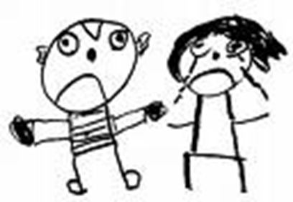
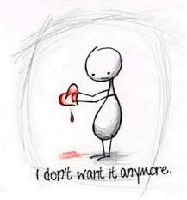
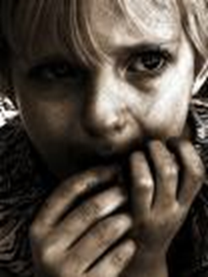
Signs & Symptoms of Abuse
What are the categories of abuse that are used in the Child Protection process?
What signs and symptoms might you expect to see for each category?

Slide 14
Signs and Symptoms of Abuse
In groups, read the scenarios, then discuss the following questions:
Is this abuse?
2. If so, which category of abuse?
3. What are you worried about?
4. If nothing changes, what impact will this have on the child?

Slide 15
Abuse… it’s a complex issue
Notes:
Refer to the fact that whenever they need more help with what to do they should refer to this document – trainers should also highlight any internal documents that are useful for participants as help and support with safeguarding.

Slide 17
Adam’s Story

Slide 18
Bristol Threshold diagram

Slide 19
Bristol Children’s Social Care Structure

Slide 20
Your role
Contribute to a safe environment
Identify children who need extra help
Identify children who are suffering/likely to suffer significant harm
Work with the Safeguarding Leads
Support the work of other agencies and professionals
Be professionally curious

Slide 21
Managing a Disclosure
Recognise – be alert for any change in student behaviour or appearance
Respond – if a student wants to talk to you, make time for them
Reassure – tell the student that they have done the right thing. Explain that you will need to pass the information on to get them help. Don’t ask any leading questions.
Refer – pass the information onto the safeguarding lead immediately
Record – make sure that you record the conversation and your observations accurately and factually in writing and pass to the safeguarding lead.

Slide 22
What we do here
Who is the Safeguarding Lead?
Who do we talk to if the Lead is not available?
How and where do we record concerns?

Slide 23
Is this safe practice?
A parent sends a friend request to a worker on Facebook, the worker accepts the friend request.
A worker/volunteer is seen showing children a picture on their phone.
A child has not been collected at the end of their activity. A worker/volunteer drives them home as it was on their way.
The child comes to you and tells you that they hurt their knee. It comes to your attention that a colleague has had to forcibly remove the child for being disruptive.
A parent has complained that another child is being continuously favoured over the others.

Slide 24
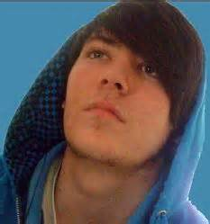
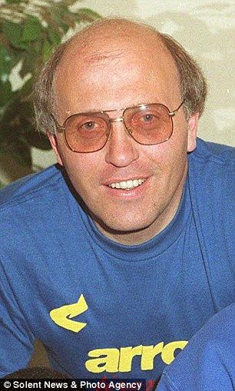
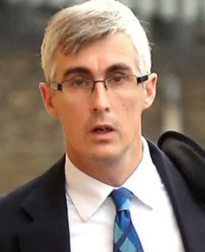
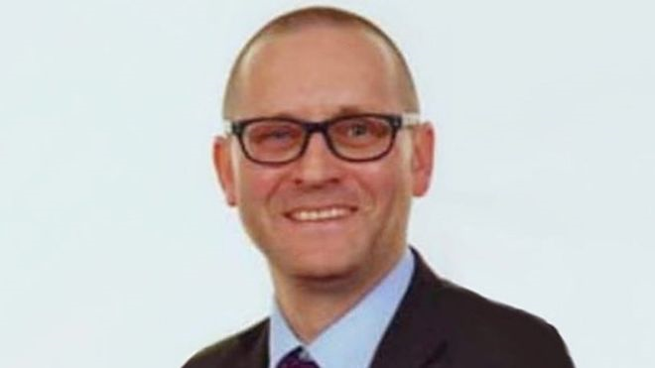
Who are these people?

Slide 25
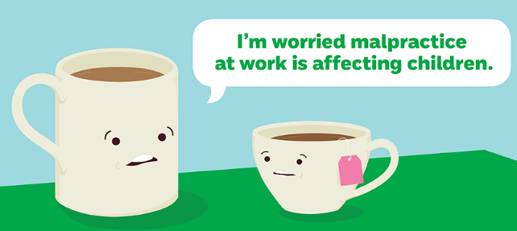
What do you do?
Report your concerns directly to the named person.
If concerns are about the named person contact the LADO
Concerns about your setting? Speak to your safeguarding lead.
Feel that you can’t raise your concerns, or genuinely feel that they are not being addressed? Consult your escalation/whistleblowing policy.

Slide 26
And finally!

